Slide 1
Welcome To Our Presentation
Course Title : Software Development

Slide 2
Presented By
Swarna Debnath ID (083)
Khoshnur Alam Mishuk ID (101)
MD Mominul Islam ID (127)
Sadia Haque ID (096)

Slide 3
Overview
Project name.
Introduction & Motivation
Objective.
How does this Project Work (Features).
System Requirement.
Design & Implementation.
Graphical Representation And Discussion.
Special Features.
Reference.
Ending.

Slide 4
Introduction
Library project system that offers many flexible and convenient features, allowing librarians and library users to maximize time and efficiency. Library System gives the all detailed information about students, librarian and books. It will track on the how many books available in library and books issued to the students. It shows popular book among the students. It keeps the record of all student whose are using this project.

Slide 5
Motivation
Libraries are essential in a process of giving citizens access to knowledge. In digital times they are needed more than ever before. In our country, library systems are written that’s why we make a great use of paper. By making paper we cut trees. It is very harmful for our environment. For our environment, we take this step to reduce this

Slide 6
Objective
Develop a system that can replace the manual library managing system.
Develop a database which stores user details & book details.
Give reliable search facility for the users.
Administrator or librarian should have logins.
Create an easy to understand user friendly environment.
Attractive user interfaces to navigate through the system for the users.

Slide 7
How does this project work(features)
Keep the record of different categories Books.
Classify the books subject wise.
The easy way to enter new books.
Keep the record of complete information of a book like; Book name, Author name, Publisher’s name, Date/ Year of publication etc
Different kind of reports on issued books sector.
The easy way to know the status of a book.

Slide 8
System Requirement
Software Requirement
Windows or Linux Operating System.
Codeblocks.
Turbo C++.
Hardware Requirement
Processor: Pentium(R) Dual-core CPU to core i-7 Processor
Minimum 2 GB RAM
256 MB or more hard disk (SSD or HDD)

Slide 9
Now let’s talk about the concepts of this program

Slide 10
Implementation
void get() ,void student(); void pass(); void librarian(); void password(); void getdata(); void show(int); void booklist(int); void modify(); void see(int); int branch(int); void issue(); void der(char[],int,int); void fine(int,int,int,int,int,int);
We added librarian and student sector for differentiate permission
Also we use lot of things.

Slide 11
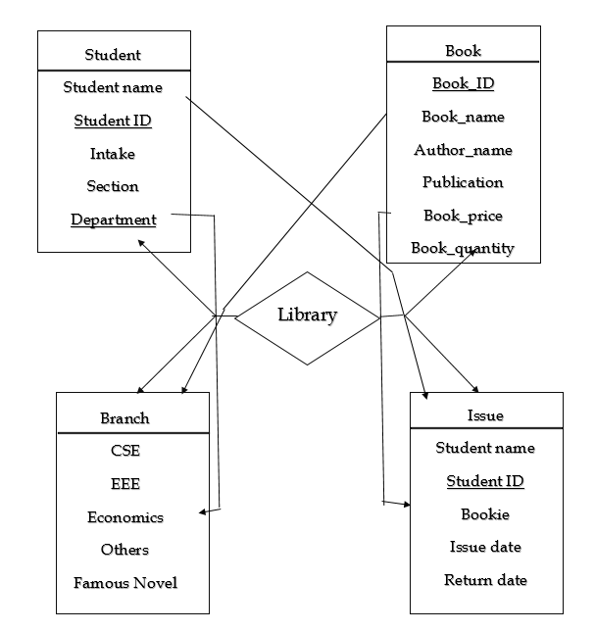
Design (ER Diagram)

Slide 12
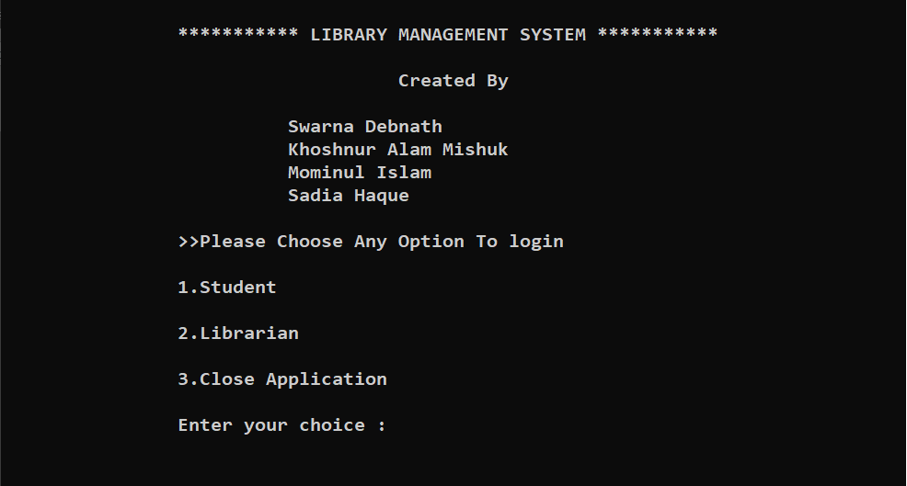
Interface (On Compiler) First Page

Slide 13
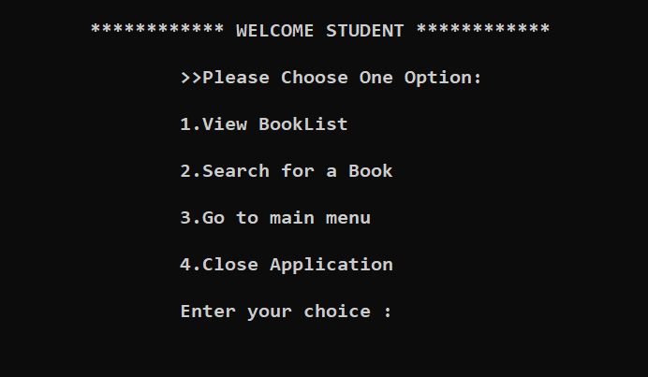
In Student Sector (On compiler)

Slide 14
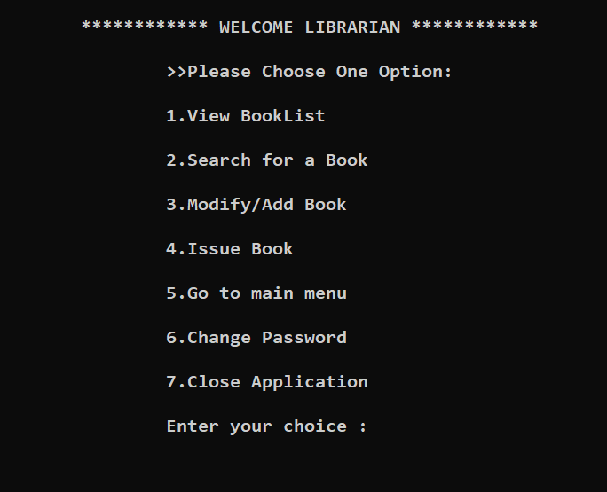
In Librarian Sector (On compiler)

Slide 15
Special Features

Slide 16
Security(Implementation)
We use Password for encrypting admin’s data. Because In this Project only librarian / Admin can access the total program. ( Not the student )

Slide 17
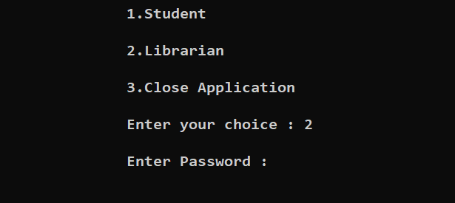
Before Asking Password (On Compiler)

Slide 18
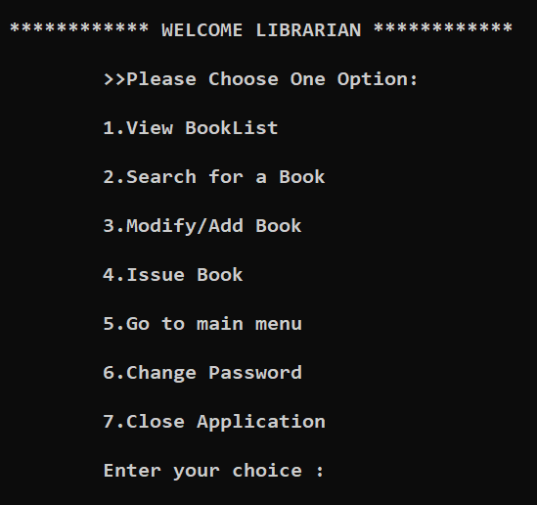
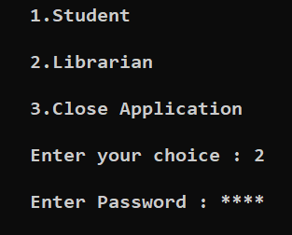
After Giving Password (On Compiler)

Slide 19
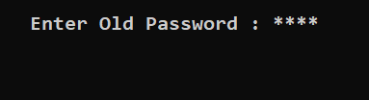
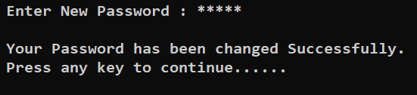
Change Password Option (Admin only)

Slide 20
Reference
1. https://codeblocks.org/downloads
3. http://www.jtattoo.net/Download.html
4. http://launch4j.sourceforge.net/
5. https://sourceforge.net
6.https://bitbucket.org/xerial/sqlite-jdbc/downloads
7. Teach Yourself C++ (BOOK)
8.https://www.youtube.com/playlist?list=PLEAQNNR8IlB4R7NfqBY1 frapYo97L6fOQ

Slide 21
So That’s it Thank You Everyone

